Slide 1
STUDENT DIRECTIONS:
For each statement, decide whether it is TRUE or FALSE.
Click and drag the circle so that your answer choice shows.
TRUE
FALSE
TRUE STATEMENT
FALSE STATEMENT
TRUE
FALSE
TRUE
FALSE

Slide 2
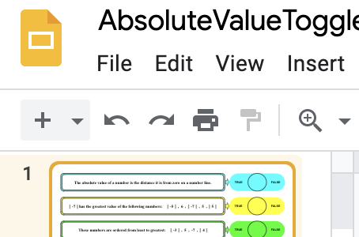
If you make a mistake or accidentally move or mess something up, use the UNDO button until you return to where you would like the slide to be.

Slide 3
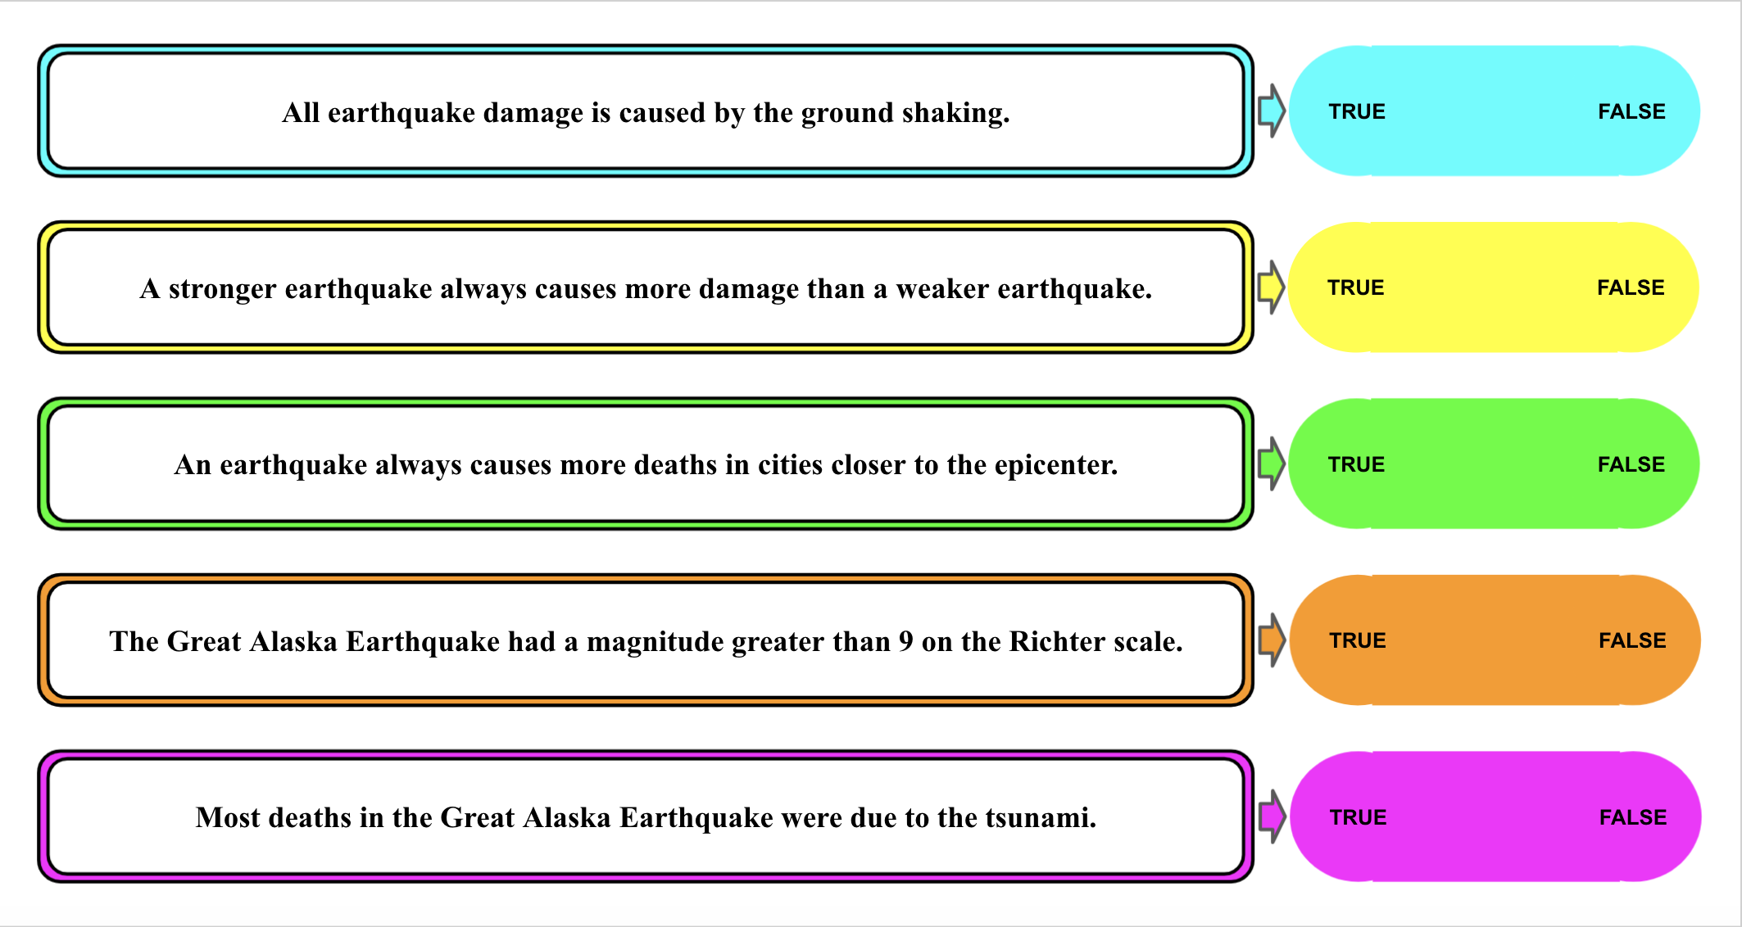
FALSE
FALSE
FALSE
FALSE
FALSE

Slide 4
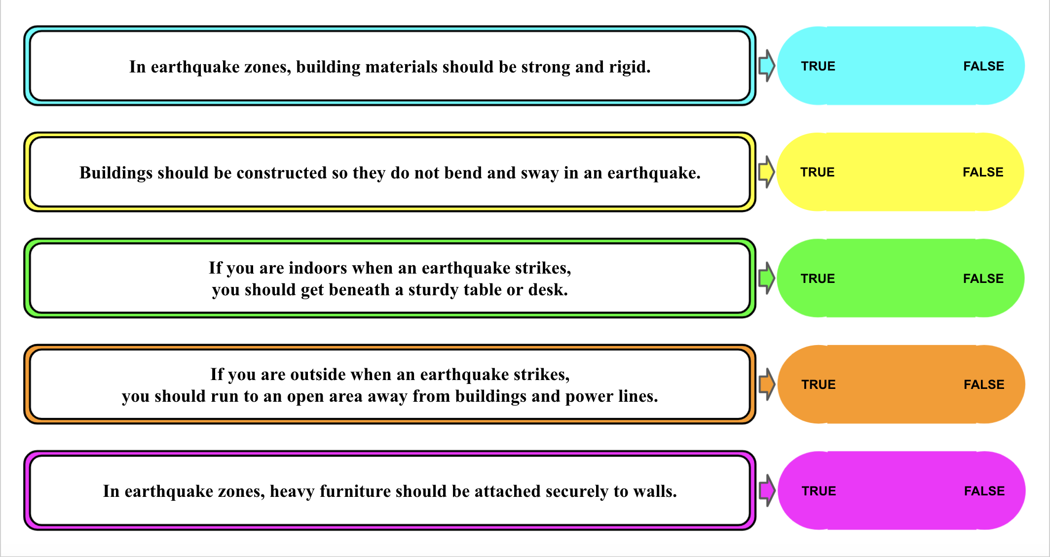

Slide 5
ANSWER KEY

Slide 6
FALSE
FALSE
FALSE
FALSE
FALSE

